Slide 1



Week 11
EXPLORATORY DATA ANALYSIS
https://intip.in/EDAIUP2022
Teaching Assistant :
Bramandika (06211940000059)
Maura Putri Defa (06211940000139)
Sepuluh Nopember Institute of Technology, Surabaya - Indonesia

Slide 2
Linear Regression
‹#›

Slide 3
Linear Regression is a linear model, a model that assumes a linear relationship between the input variables (x) and the single output variable (y). More specifically, that y can be calculated from a linear combination of the input variables (x).

Slide 4
When there is a single input variable (x), the method is referred to as simple linear regression. When there are multiple input variables, literature from statistics often refers to the method as multiple linear regression.

Slide 5
Techniques that used in Linear Regression Model :
Simple linear regression
Ordinary Least Squares
Gradient descent
Regularization
There are many method that we can use but in this section we are going to focus on Ordinary Least Squares or OLS

Slide 6
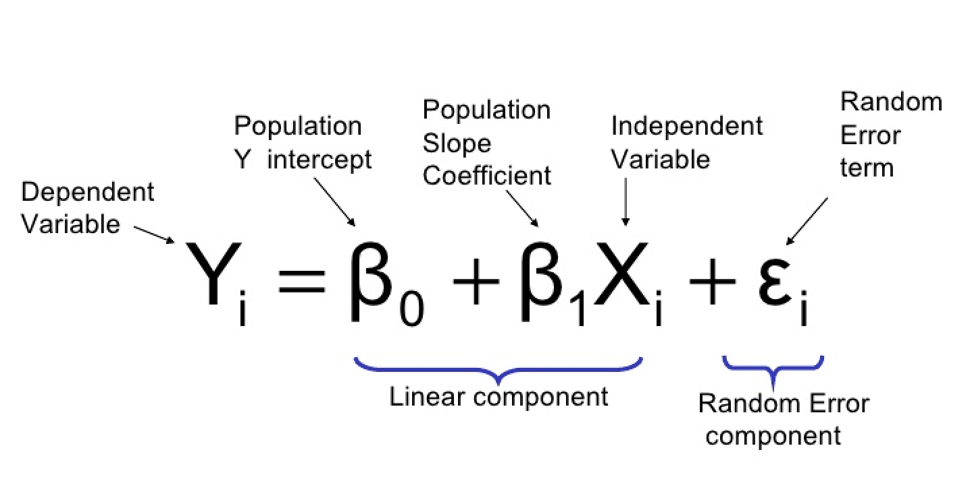
Ordinary Least Squares
When we have more than one input we can use Ordinary Least Squares to estimate the values of the coefficients.
The Ordinary Least Squares procedure seeks to minimize the sum of the squared residuals. This means that given a regression line through the data we calculate the distance from each data point to the regression line, square it, and sum all of the squared errors together. This is the quantity that ordinary least squares seeks to minimize.
‹#›
Exploratory Data Analysis 2021

Slide 7
Assumptions
There are four assumptions associated with a linear regression model:
Linearity: The relationship between X and the mean of Y is linear.
Homoscedasticity: The variance of residual is the same for any value of X.
Independence: Observations are independent of each other.
Normality: For any fixed value of X, Y is normally distributed.
‹#›
Exploratory Data Analysis 2021

Slide 8
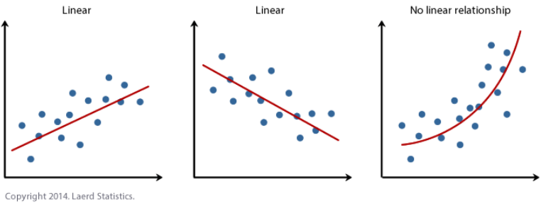
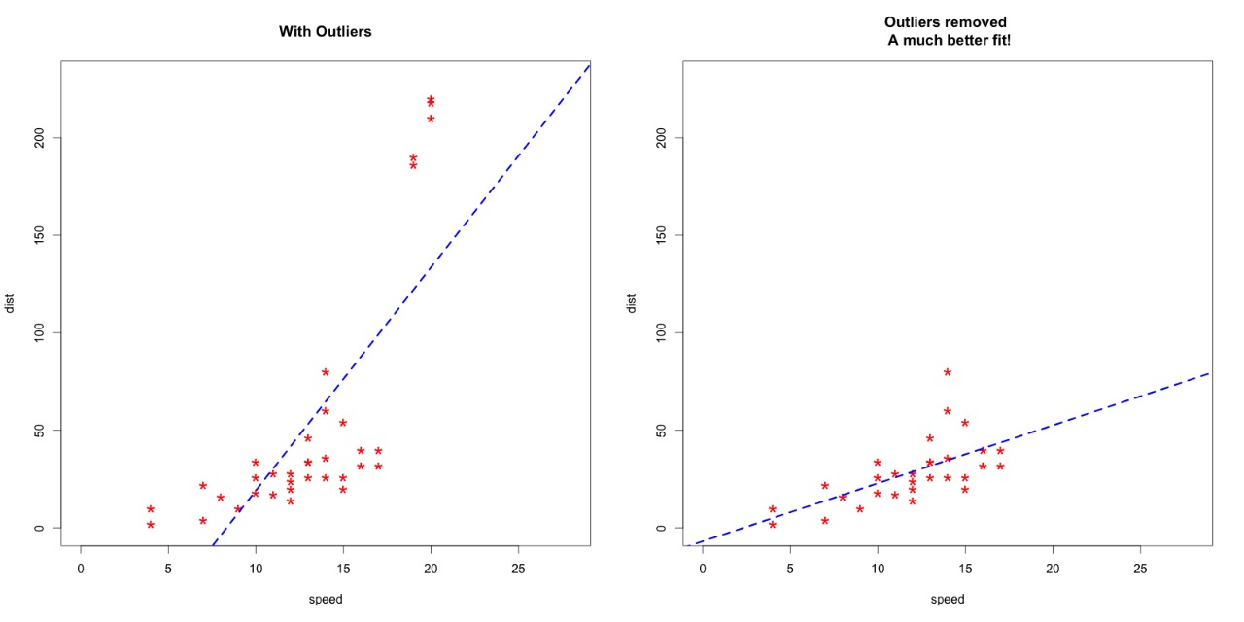
Linearity
The dependence of the output on the input is defined by a linear function
Normality
You can check whether the x and y are normality or not from the histogram or from Kolmogorov Smirnov (check the P-value)
‹#›
Exploratory Data Analysis 2021

Slide 9
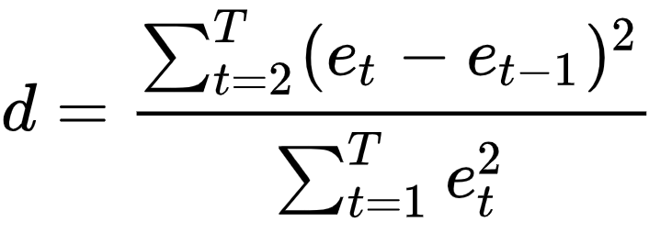
Independence
You can check whether the x and y are independence or not from the ACF plot or from Durbin Watson (check the P-value). The Durbin Watson test looks for a specific type of serial correlation, the AR(1) process.
Exploratory Data Analysis 2021
The Hypotheses for the Durbin Watson test are:
H0 = no first order autocorrelation.
H1 = first order correlation exists.
(For a first order correlation, the lag is one time unit).
Assumptions are:
That the errors are normally distributed with a mean of 0.
The errors are stationary.
The test statistic is calculated with the following formula:
‹#›

Slide 10
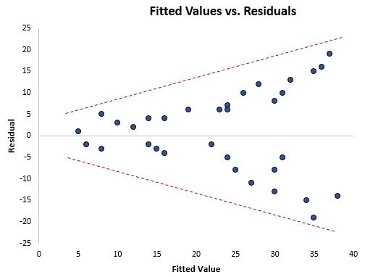
Homoscedasticity
In regression analysis, heteroscedasticity (sometimes spelled heteroskedasticity) refers to the unequal scatter of residuals or error terms. Specifically, it refers to the case where there is a systematic change in the spread of the residuals over the range of measured
Heteroscedasticity is a problem because OLS regression assumes that the residuals come from a population that has homoscedasticity, which means constant variance.
When heteroscedasticity is present in a regression analysis, the results of the analysis become hard to trust. Specifically, heteroscedasticity increases the variance of the regression coefficient estimates, but the regression model doesn’t pick up on this.values.
Exploratory Data Analysis 2021
‹#›

Slide 11
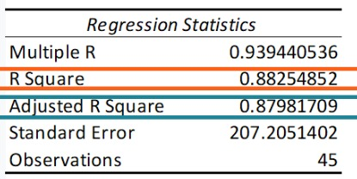
Interpretation
R-square Interpretation
The most common interpretation of r-squared is how well the regression model fits the observed data. For example, an r-squared of 60% reveals that 60% of the data fit the regression model. Generally, a higher r-squared indicates a better fit for the model.
Exploratory Data Analysis 2021
‹#›

Slide 12
Robust Regression
‹#›

Slide 13
Robust regression is an alternative to least squares regression when data are contaminated with outliers or influential observations, and it can also be used for the purpose of detecting influential observations.
‹#›
Exploratory Data Analysis 2021

Slide 14
Introduction
Residual: The difference between the predicted value (based on the regression equation) and the actual, observed value.
Outlier: In linear regression, an outlier is an observation with large residual. In other words, it is an observation whose dependent-variable value is unusual given its value on the predictor variables. An outlier may indicate a sample peculiarity or may indicate a data entry error or other problem.
Leverage: An observation with an extreme value on a predictor variable is a point with high leverage. Leverage is a measure of how far an independent variable deviates from its mean. High leverage points can have a great amount of effect on the estimate of regression coefficients.
Influence: An observation is said to be influential if removing the observation substantially changes the estimate of the regression coefficients. Influence can be thought of as the product of leverage and outlierness.
Cook’s distance (or Cook’s D): A measure that combines the information of leverage and residual of the observation.
‹#›
Exploratory Data Analysis 2021

Slide 15
M-Estimation
Linear least-squares estimates can behave badly when the error distribution is not normal, particularly when the errors are heavy-tailed. One remedy is to remove influential observations from the least-squares fit. Another approach, termed robust regression, is to use a fitting criterion that is not as vulnerable as least squares to unusual data. The most common general method of robust regression is M-estimation. This class of estimators can be regarded as a generalization of maximum-likelihood estimation,hence the term “M”-estimation.
*read the journal on our gdrive week 11
‹#›
Exploratory Data Analysis 2021

Slide 16
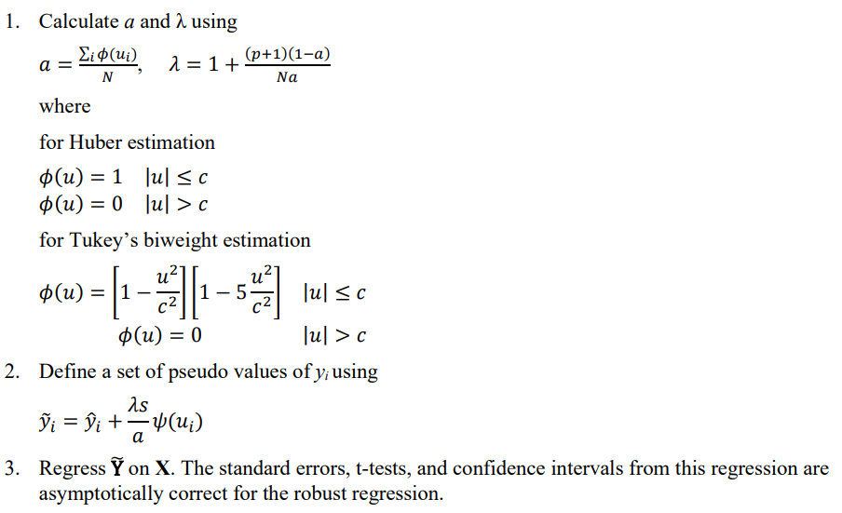
Standard Errors and Tests for M-Estimates
‹#›
Exploratory Data Analysis 2021

Slide 17
Thank you!

